Slide 1
RECARP for the virtual seminar series
By: Osei-Tutu Desmond

Slide 2
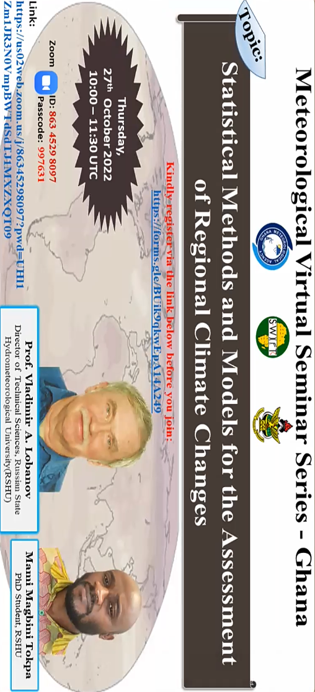

Slide 3
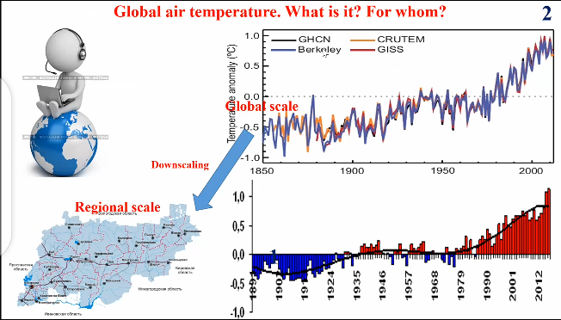

Slide 4
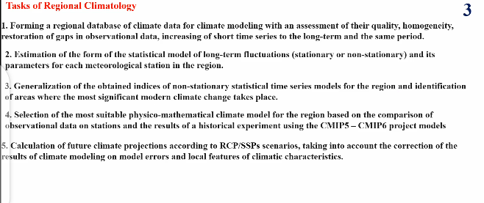

Slide 5
Statistical Methods And Models For The Assessment of Regional Climate Changes
Models And Methods
Statistical models of intra-annual fluctuations and spatial models
Statistical methods for estimating the homogeneity of empirical distributions.
Statistical models of time series(stationary sample and non stationary models of linear trend and stepwise changes), indicators of efficiency and statistical significance of non-stationary models

Slide 6
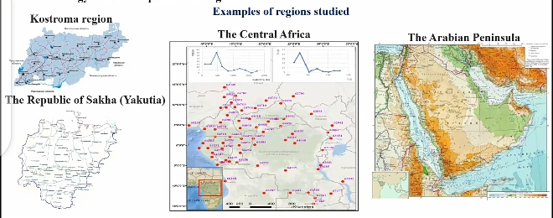

Slide 7
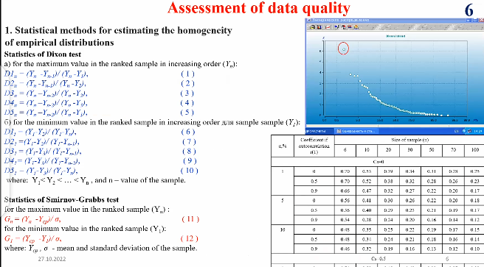

Slide 8
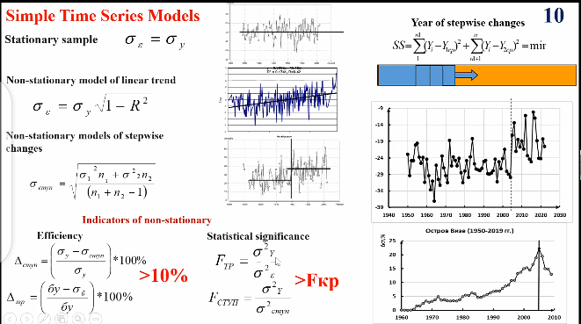

Slide 9
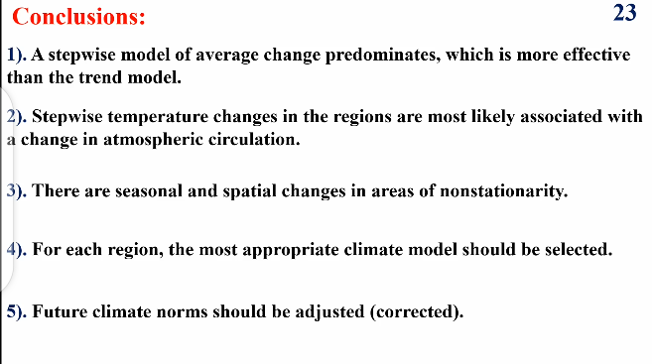

Slide 10
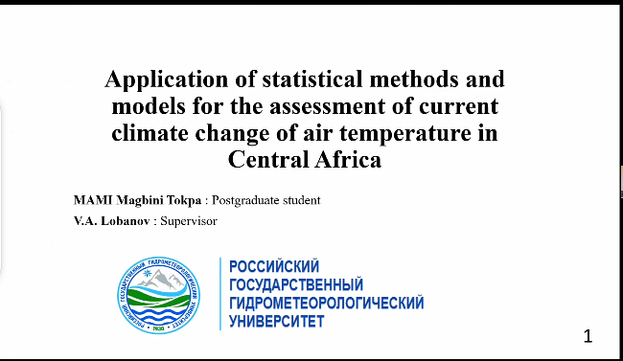

Slide 11
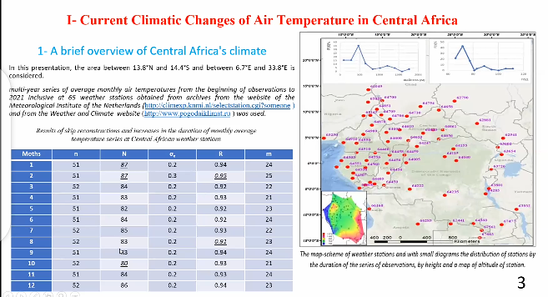

Slide 12
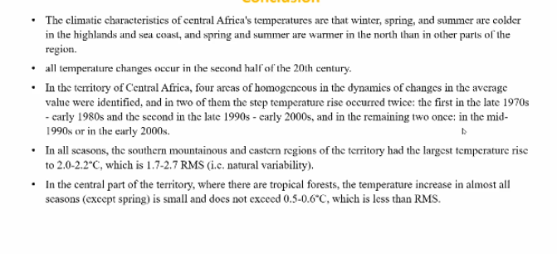
CONT.
The climate characteristics of central Africa’s temperatures that winter and spring are

Slide 13
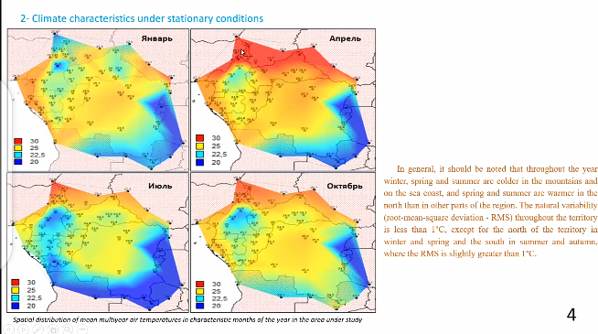

Slide 14
THANK YOU !!!!!
WELCOME!!!

